Slide 1
Robot Cognition
Team Toucan
Conceptual Design Report
Sponsor: Bill Michael
Faculty Sponsor: Leslie Tekamp
10-7-2022

Slide 2
Contents
Problem Specification
Hardware Integration
Platform Structure Design

Slide 3
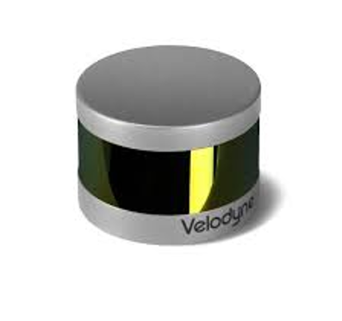
Problem Specification
The goal of this project is to create a platform that can incorporate sensors to allow for the mapping of its surrounding area.
Sensors that will be used are:
GPS
Inertial Measurement Unit (IMU)
LIDAR
Camera
The platform must weigh less than 5kg
Formats data into a single processing system

Slide 4
Problem Specification
The platform must also provide additional ports:
5VDC at 10A
3.3VDC at 10A
12VDC at 5A
Must be fully functional from –10º to 40º C

Slide 5
Major Hardware
Processor: NVIDIA Jetson Nano
Integrate the following onto one platform:
Xsens MTI-10-2A8G4 (Inertial measurement unit)
Ublox LEA-M8T with WD22UGRC interface board (Global positioning system)
Velodyne LiDAR PUCK 16 (LIDAR)
e-CAM24_CUNX (Camera)
Need to consider a power source

Slide 6
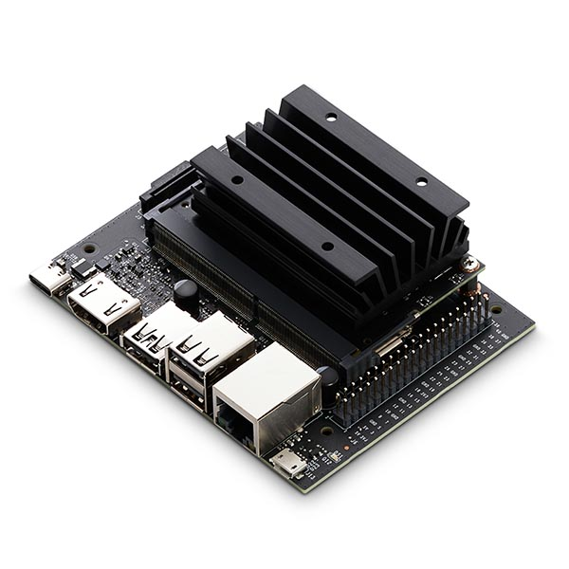
NVIDIA Jetson Nano
GPU | 128-core NVIDIA Maxwell™
CPU | Quad-core ARM® A57 @ 1.43 GHz
Memory | 2 GB 64-bit LPDDR4 25.6 GB/s
Storage | microSD
Video Encode | 4Kp30 | 4x 1080p30 | 9x 720p30 (H.264/H.265)
Video Decode | 4Kp60 | 2x 4Kp30 | 8x 1080p30 | 18x 720p30 (H.264/H.265)
Connectivity | Gigabit Ethernet, 802.11ac wireless
Camera | 1x MIPI CSI-2 connector
Display | HDMI
USB | 1x USB 3.0 Type A,2x USB 2.0 Type A, USB 2.0 Micro-B
Others | 40-pin header (GPIO, I2C, I2S, SPI, UART) 12-pin header (Power and related signals, UART) 4-pin Fan header

Slide 7
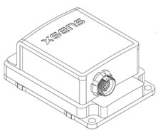
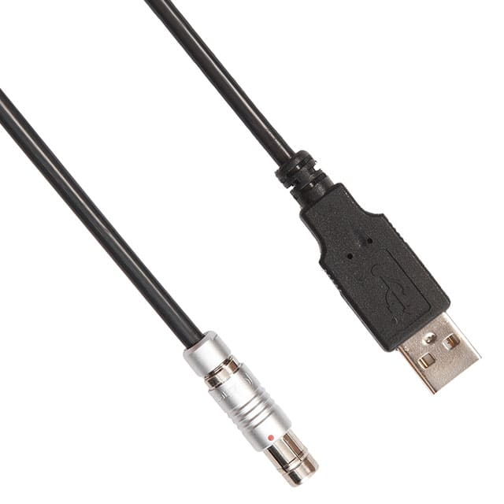
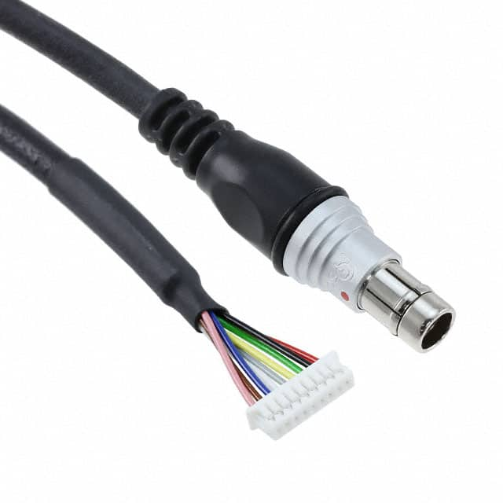
IMU Integration
Xsens MTI-10-2A8G4
Currently have CA-MP2-MTI
Serial connector
Alternative CA-USB-MTI
Allow for easier integration with USB
CA-MP2-MTI
CA-USB-MTI

Slide 8
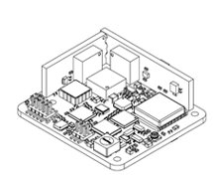
IMU Alternative
Xsens MTI-OEM
UART Communication Protocol
Provides flexibility if we run into integration issues

Slide 9
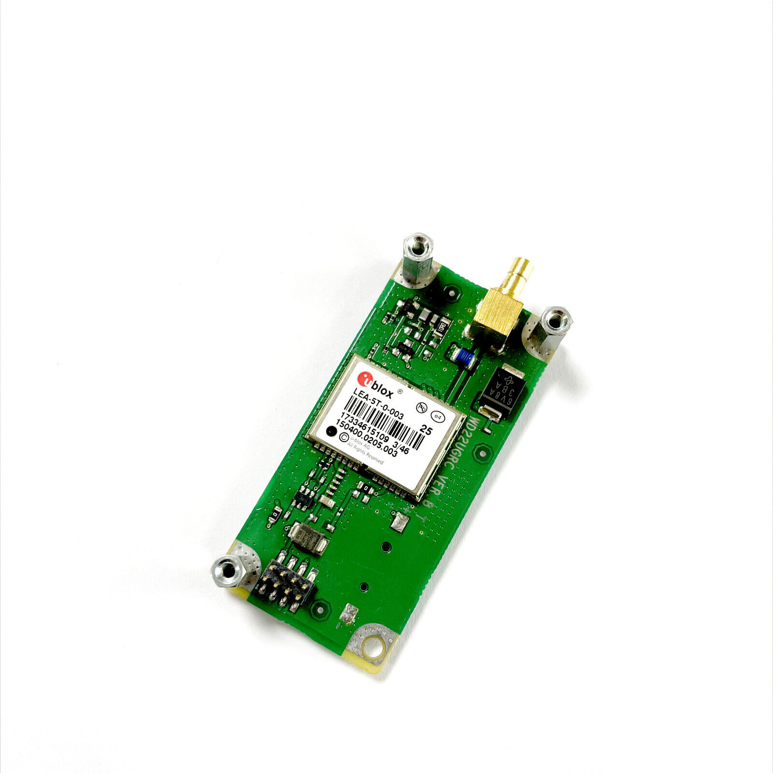
GPS Integration
Ublox LEA-M8T
SPI (serial peripheral interface)
UART
I2C (inter-integrated circuit) communication protocols
Plan to use UART communication protocol
Needs to be integrated with an Antenna

Slide 10
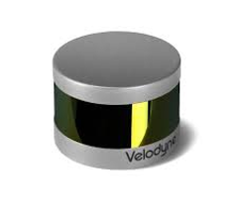
LIDAR Integration
Velodyne LiDAR PUCK 16
Ethernet Communication protocol

Slide 11
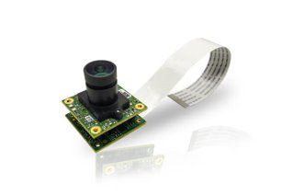
Camera Integration
e-CAM24_CUNX
MIPI camera serial interface 2 (CSI-2) communication protocol
Connects directly to Jetson Nano

Slide 12
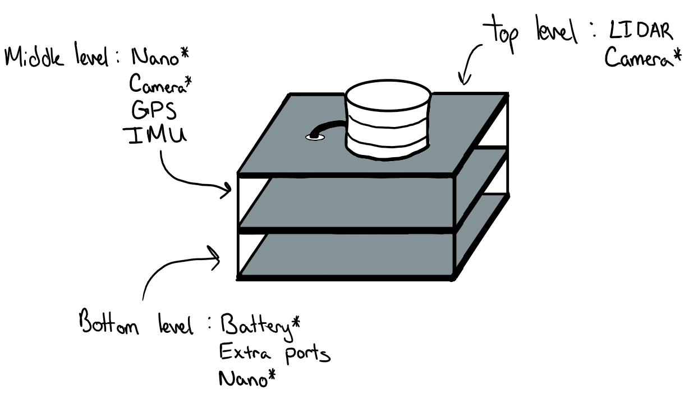
Design Ideas
Idea #1
Platform:
Compact
2-3 Levels
Convenient Mounting points
Open layout
(Not closed on sides)

Slide 13
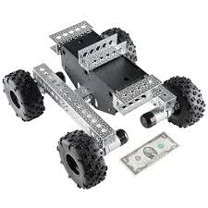
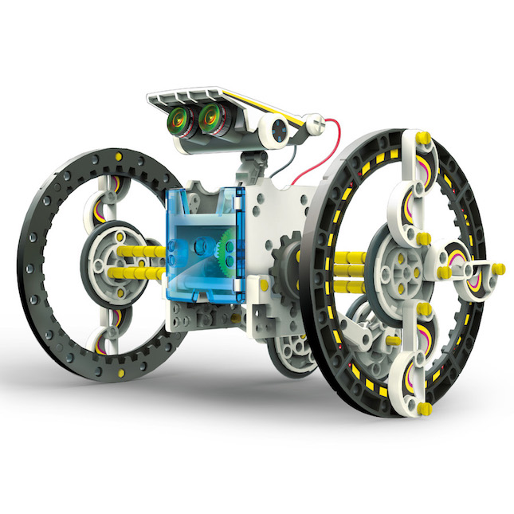
Design Ideas
Idea #2
Mobility:
2 large powered tires + 1 small (stability)
v.s 4 tires on a solid chassis.
Convenient Mounting points
Open layout (Not closed on sides)
Consumables, budget, variables (speed, power cap..),
Feature Creep, design complexity and deadlines, etc..

Slide 14
Design Ideas
Idea #3
One platform
Lower center of gravity (more stable)
3D printed custom platform
Antenna
Extra ports
IMU
Jetson Nano
GPS
LIDAR
Camera
Front

Slide 15
Problem Requirements
Requirement​ | ​
Power Supply​ | 18-48V​
Peripherals​ | GPS, IMU, LIDAR, Camera​
Power Output ​ | 5VDC at 10A​
Power Output​ | 3.3VDC at 10A​
Power Output​ | 12VDC at 5A​
Generates​ | Point-cloud data, spatial and image data, location data​
Collects ​ | Accurate geo positioning, image and video collection, attitude and gyroscope data, inertial data​
Requirement: A sensor platform to be built that is capable of taking information from the surrounding area and processing for a cognition robot.

Slide 16
Comparison of Solution Concepts to Problem Requirements and Decision Matrix
Requirement | Design 1 (Multiplatform) | Design 2 | Design 3 (Single platform)
Capable of taking in information | Provides camera and LIDAR with full view 10 |  | Objects intersecting view of camera and LIDAR 5

Slide 17

Concept Recommendation
Recommend design idea 1

Slide 18
Bill of Materials
Item | Unit | Quantity | Total | Manufacturer | Description
e-CAM24_CUNX | $154.00 | 1 | $154.00 | E-con Systems | Camera
NVIDIA Jetson Nano | $59.00 | 1 | $59.00 | Nvidia | processing unit
Velodyne LIDAR PUCK 16 | $4,000.00 | 1 | $4,000.00 | Velodyne | LIDAR
Xsens MTI-10-2A8G4 | $759.00 | 1 | $759.00 | Xsens | IMU
Ublox LEA-M8T | $89.00 | 1 | $89.00 | U-blox | GPS
3D Print Platform | ? | 1 | ?
Total |  |  | $5061.00

Slide 19
Plan to Complete Design (Deadlines)
September 16: Conceptual Design Report
October 7: Critical Design Documents
October 14: Finish sensor integration
November 11: Finish software integration
December 2: Final Report

